Slide 1
Carnegie Mellon University
16-762 · Mobile Manipulation · Spring 2026
FINAL PROJECT PRESENTATION
Stretch 3 Object Rearrangement
A three-module ROS 2 system for natural-language, VLM-planned pick-and-place on a mobile manipulator.
TEAM
PLATFORM
DATE
Haokun · Jinyao · Weerachai
Hello Robot Stretch 3
April 2026
Notes:
Thanks for having us. I'm presenting our 16-762 final project: an end-to-end object rearrangement system on the Stretch 3 mobile manipulator. In short, an operator gives the robot a natural-language instruction like 'put the orange cup in region B,' and the robot autonomously navigates around an apartment, picks up the right objects, and places them in the right regions. I'll walk through our motivation, the system architecture, each of the three main modules, and then our evaluation and live-ish demo. About ten minutes.

Slide 2
MOTIVATION
01 / 12
A LONG-STANDING PROBLEM
5+
Tidying a room is still unsolved.
systems
TO COORDINATE PER TASK
10m+
TYPICAL BASE TRAVEL PER INSTRUCTION
Rearrangement stitches together SLAM, semantic perception, long-horizon planning, and manipulation under uncertainty — the full mobile-manipulation stack, end to end.
~cm
GRASP TOLERANCE, AFTER DRIVING
16-762 · STRETCH REARRANGEMENT
HAOKUN · JINYAO · WEERACHAI
Notes:
The motivation is simple. Household rearrangement is still one of the least-solved mobile manipulation problems. It stitches together everything hard: SLAM, semantic perception, long-horizon task planning, visual servoing, and manipulation under uncertainty. And unlike a tabletop pick-and-place, the robot has to drive across a room, re-localize, and then grasp something that may have moved since it was last seen. Our question was: given a Stretch 3, a Gemini-class VLM, and about ten weeks, can we build a system that actually does this end-to-end in a real apartment?

Slide 3
PROBLEM DEFINITION
02 / 12
Natural-language rearrangement in a pre-mapped room.
GIVEN
FIND
G1
A saved occupancy map of the environment (stretch_nav2, offline).
F1
An ordered pick-place plan satisfying the instruction.
F2
Navigation goals the Stretch can actually reach.
G2
A snapshot of every target object's position in the map frame.
F3
Grasp poses that succeed on real cups and bottles.
G3
Annotated regions — polygons + a place anchor, in YAML.
ASSUMPTIONS
G4
A free-form instruction such as "put the orange cup to region B."
Static map · small graspable objects (cups, bottles) · good lighting · operator-in-the-loop for region annotation (one-time).
16-762 · STRETCH REARRANGEMENT
02
Notes:
Concretely, the task is: the operator pre-builds an occupancy map of a room, annotates a handful of semantic regions like A, B, C, D — think 'the coffee table' or 'the counter' — and snapshots where every target object starts. Then at runtime they give a free-form instruction. The robot has to interpret the instruction, pick each object up off a surface, drive to the correct region, and place it there. Our assumptions: objects are small, graspable cups and bottles; the map is static; and we assume good lighting for the RGB-D cameras.

Slide 4
RELATED WORK
03 / 12
Three threads we stand on.
01 · LLM PLANNERS
02 · STRETCH STACK
03 · OPEN-VOCAB DETECTORS
Open-vocabulary rearrangement
Reliable mobile base
YOLOE + D405 close-range
HomeRobot (Yenamandra et al.) and TidyBot (Wu et al.) show LLM-driven household cleanup is feasible end-to-end.
stretch_nav2 + AMCL give us planning, costmaps, and localization; stretch_core exposes head D435i + gripper D405.
YOLOE (Ultralytics) provides promptable segmentation; the D405 gripper camera enables a second, close-range detection pass.
Takeaway: grounding is the bottleneck, not the planner.
We reuse — not rebuild — the navigation layer.
Two cameras → two-stage visual grasp.
Our contribution is the integration pattern : a thin topic contract between VLM planner, navigation coordinator, and two-stage manipulation that keeps each module independently testable on hardware.
16-762 · STRETCH REARRANGEMENT
03
Notes:
Quick lay of the land. We drew on three threads. HomeRobot and TidyBot showed end-to-end open-vocabulary rearrangement is possible with LLM planners. The Stretch ecosystem — stretch_nav2, stretch_core — gave us a solid Nav2 + AMCL stack for free. And recent open-vocabulary detectors like YOLOE and the D405 gripper camera on Stretch 3 are what make our two-stage visual grasp pipeline feasible at all. Our contribution is how we glue these together into a reliable system, not any one component.

Slide 5
PART I
STRETCH REARRANGEMENT
§ 04 — ARCHITECTURE
Three nodes, one topic contract.
Task planner → task executor → navigation & manipulation. Standard ROS 2 messages only — no custom types.
04 / 12
HAOKUN · JINYAO · WEERACHAI
Notes:
This is the whole system on one slide. Three loosely-coupled ROS 2 nodes, connected by standard message types — no custom messages. The task planner is a Gemini-2.5-flash VLM that turns the instruction plus the scene into an ordered pick-place plan. The task executor is the coordinator: it issues nav goals, waits for arrival, issues pick or place, waits for completion, and moves on. Navigation wraps stretch_nav2. Manipulation is our two-stage visual grasp. The key design choice was keeping each module behind a thin topic contract so we could develop and test them independently.

Slide 6
SYSTEM OVERVIEW
05 / 12
End-to-end data flow.
Operator
task_planner_node
task_executor_node
/instruction/text
→
Gemini 2.5 Flash · VLM
→
Coordinator · state machine
"put the orange cup in B…"
JSON plan · ordered (pick, place) pairs
Dispatches goals + pick/place actions
↓ /nav/goals, /nav/control_flag
↑ /nav/arrived_flag
Perception
manipulation_node
navigation_node
YOLOE · D435i · D405
→
two-stage visual grasp
←
stretch_nav2 · Nav2 · AMCL
/detector/objects (Detection3DArray)
coarse (head) → fine (gripper)
Cancels Nav2 at 1 m · hands off
std_msgs/String
geometry_msgs/PoseArray
vision_msgs/Detection3DArray
control_msgs/FollowJointTrajectory
std_srvs/Trigger
16-762 · STRETCH REARRANGEMENT
05
Notes:
Stage one is offline: we build the map. We run stretch_nav2's offline mapping, teleop the robot around the room, and simultaneously run a YOLOE detector on the head D435i camera. Every time it sees a target object, it latches that object's position in the map frame. When we're done, a single service call snapshots all the positions into a YAML file, and we save the occupancy map. So the robot starts every run knowing roughly where everything is.

Slide 7
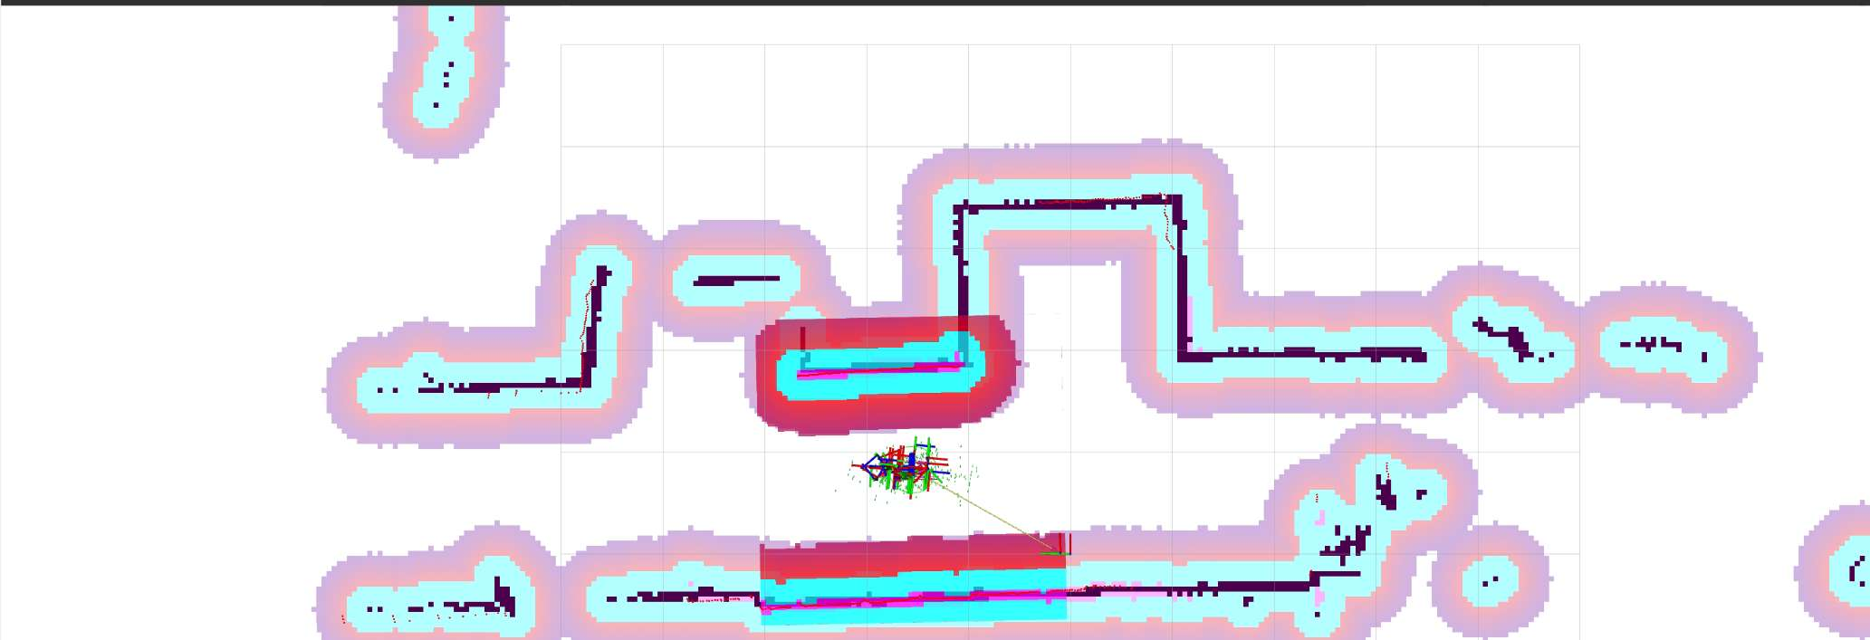
STAGE 1 — MAP & SNAPSHOT
06 / 12
OFFLINE · ONE-TIME PER ROOM
Teleop once, remember everything.
T1
SLAM + driver via stretch_nav2 offline_mapping.
T2
D435i camera streaming RGB-D at low resolution.
T3
YOLOE detector latches each object's pose in the map frame.
One service call freezes the scene, one command saves the map.
# snapshot every detected object into YAML ros2 service call /detector/snapshot std_srvs/srv/Trigger # save the occupancy map ros2 run nav2_map_server map_saver_cli -f ~/maps/myroom
FIG 1 · myroom.pgm · Nav2 inflated costmap in RViz
# myroom_objects.yaml orange_cup: {x: 1.82, y: 0.43, conf: 0.91} yellow_cup: {x: -0.74, y: 1.91, conf: 0.88} white_bottle: {x: 2.31, y: -1.05, conf: 0.94}
16-762 · STRETCH REARRANGEMENT
06
Notes:
Stage two is a five-minute manual step. We open the map in RViz, click 'Publish Point' on the corners of each region we care about, and drop those vertices into a YAML file. Each region is a CCW polygon plus a place_anchor — the pose the robot will drive to when it wants to place something there. We chose this over learning regions because for a course project, a human in the loop here is far more reliable than a clustering heuristic, and it takes five minutes per room.

Slide 8
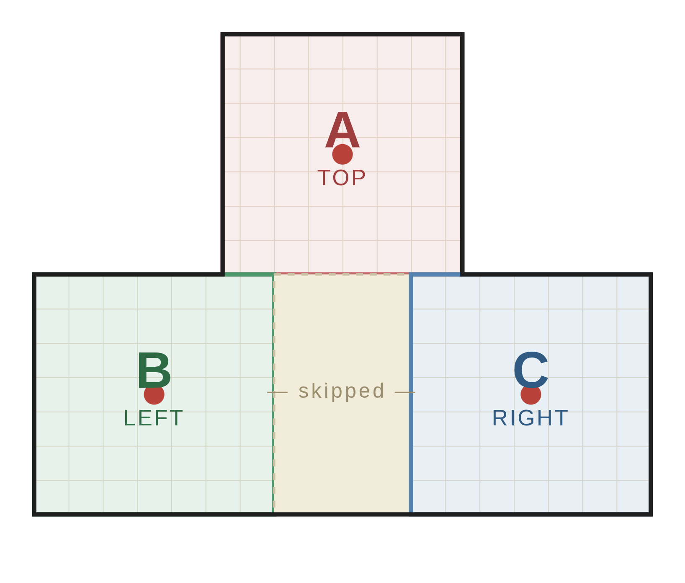
STAGE 2 — REGION ANNOTATION
07 / 12
HUMAN-IN-THE-LOOP · 5 MINUTES
Semantic regions as CCW polygons.
Each region is a polygon in the map frame plus a place_anchor — the pose the robot drives to when placing.
# regions.yaml - name: A polygon: - [0.0, 0.0] - [3.0, 0.0] - [3.0, 3.0] - [0.0, 3.0] place_anchor: [1.5, 1.5, 0.0]
Cross-checked in RViz with Publish Point . We chose a manual step over learned segmentation — far more reliable for 5 min of work, and easy to re-use.
16-762 · STRETCH REARRANGEMENT
07
FIG 2 · T-SHAPED ROOM · THREE LABELLED REGIONS (TOP / LEFT / RIGHT) · RED DOTS = PLACE ANCHORS
Notes:
At runtime, the VLM planner does the heavy lifting. It receives the robot's current pose, the detected object list with positions and which region they're currently in, the region polygons and place anchors, and the operator's free-form instruction. We prompt Gemini-2.5-flash to output a strict JSON plan: an ordered list of (object, target_region) tuples that minimizes travel distance. The prompt enforces exact-match object labels and region names, skips already-placed objects, and retries on malformed output. Importantly, we can also pass a context image so the VLM can break ties the pose list alone can't resolve.

Slide 9
STAGE 3 · TASK PLANNER
08 / 12
GEMINI 2.5 FLASH · STRICT JSON OUTPUT
From instruction to pick-place plan.
IN
Robot pose · object list (label, xy, current region) · regions · instruction.
# operator message user › "put the orange cup to region B, put the yellow cup to region A." # Gemini output (parsed) { "reasoning": "visit yellow first — closer" , "tasks": [ { "object_label": "yellow_cup", "target_region": "A", "order_index": 0 }, { "object_label": "orange_cup", "target_region": "B", "order_index": 1 } ] }
IN
Optional context image from the head camera for disambiguation.
OUT
JSON: {tasks: [(object, region, order_index)]} , travel-minimizing.
REL
Exact-match label + region validation, 5-retry exponential backoff on malformed output.
The planner skips objects already in their desired region — replanning from detector updates is automatic.
16-762 · STRETCH REARRANGEMENT
08
Notes:
The navigation coordinator is the glue. It's a small state machine: it holds the pose array from the planner, and when the executor says 'proceed,' it dispatches goal i to Nav2. Instead of waiting for Nav2 to drive all the way to the pose — Nav2 will happily try to plan into the exact place_anchor, which is often too close to a wall — we poll TF and cancel Nav2 as soon as the base is within one meter of the goal. Then we publish 'arrived' and wait. This cancel-early pattern is what makes handoff to manipulation clean and fast, and it's tolerant to Nav2 stalls.

Slide 10
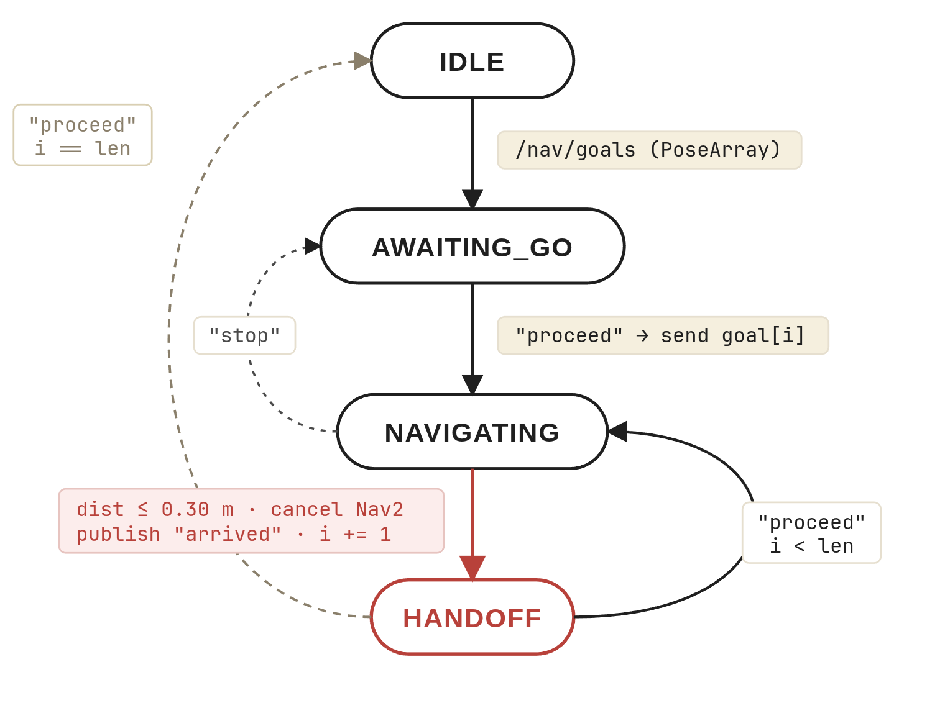
NAVIGATION COORDINATOR
09 / 12
A tiny state machine around Nav2.
Nav2 handles global planning and costmaps; our coordinator handles when to stop and who goes next.
IDLE → AWAITING_GO
on /nav/goals (PoseArray)
↓
AWAITING_GO → NAVIGATING
on "proceed" → dispatch Nav2 goal[i]
↓
NAVIGATING → HANDOFF
distance ≤ STOP_DISTANCE_M (or Nav2 done early) · cancel Nav2 · publish "arrived" · i += 1
↓
HANDOFF → NAVIGATING · or IDLE
on "proceed": re-dispatch goal[i] if i < len, else return to IDLE
FIG 3 · Coordinator state machine · from navigation_node.py
16-762 · STRETCH REARRANGEMENT
09
KEY DESIGN CHOICE
Cancel Nav2 early at STOP_DISTANCE_M = 0.30 m — avoids costmap stalls near walls and keeps handoffs fast.
Notes:
Grasping was the part we iterated on the most, and we ended up with something simpler than we expected. Every pick starts by driving the arm to a single fixed joint configuration — same lift, same extension, same wrist pitch — that points the gripper, and the D405 camera on it, straight at the object sitting on the surface. Because Nav2 has already placed the base within a known tolerance of the pick anchor, this open-loop pre-pose is enough to reliably get the object into the D405's field of view. From there, the gripper camera takes over: it publishes a refined 3D pose, and we IK-step the hand toward it until we're within six centimeters, apply a small grasp offset, close, and retract. No head-camera IK loop, no parallax problem — just a fixed pose and one tight closed-loop servo.

Slide 11
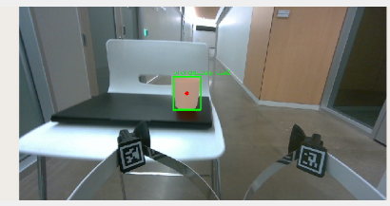
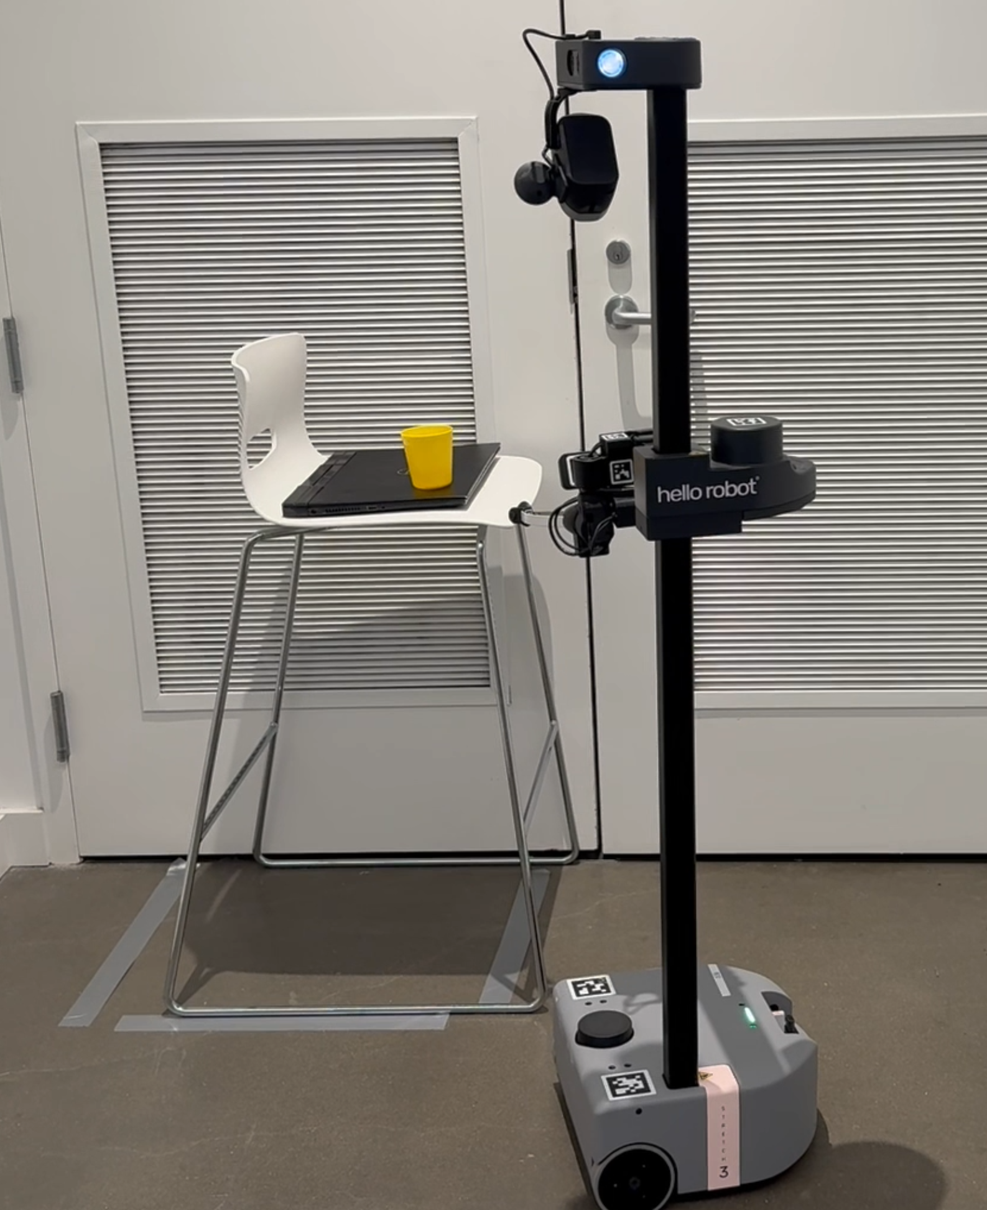
FIXED-POSE VISUAL GRASP
10 / 12
FIXED READY POSE → GRIPPER D405 SERVO
Pre-pose the arm, then servo with the hand.
→
STAGE 1 · FIXED READY POSE
STAGE 2 · GRIPPER-CAMERA SERVO
Open-loop arm pre-position
visual_grasp_node
Every pick starts the same: the arm is driven to a single hard-coded joint configuration that points the gripper — and the D405 — toward the object on the surface.
D405 publishes a refined pose in base_link ; IK-step the gripper toward it until within 6 cm, apply grasp offset, close, retract.
16-762 · STRETCH REARRANGEMENT
δ = 0.06 m · shift = [0.04, -0.03, 0.03]
10
lift = 0.90 m · extension = 0.10 m · wrist_pitch = -π/2
Why a fixed pose? Because Nav2 already places the base within a known tolerance of each pick anchor, an open-loop ready pose gets the object reliably into the D405 FOV without needing head-camera IK — then closed-loop visual servoing handles the last few centimeters.
Notes:
Rather than walking through a stage-by-stage table, let me just show you the full thing running. This is an end-to-end run on real hardware: the operator types an instruction, the VLM plans, the robot navigates across the room, picks up the cup, drives to the target region, and places it — then goes back for the second object. One take, no cuts. Watch the handoffs between modules — you can see the base stopping about a meter out, the gripper servoing in, and the D405 view taking over for the final approach.

Slide 12
LIVE DEMO
11 / 12
END-TO-END RUN · REAL HARDWARE
instruction → plan → nav → pick → place
Full rearrangement demo.
▶
DROP
DEMO.MP4
IN THE PROJECT FOLDER
16-762 · STRETCH REARRANGEMENT
11
FIG 4 · Stretch 3 · two cups → regions A & B
press ▶ to play
Notes:
Where it breaks and what's next. Failure modes cluster in three places: reflective or thin objects that confuse the D405 depth, cluttered pick poses where our grasp offset is wrong, and VLM plans that occasionally hallucinate a region name despite the prompt constraints. Near-term fixes: a learned grasp predictor to replace the hand-tuned shift_x/y/z offsets; a replanning loop when the detector re-finds a moved object; and a small finetune on the VLM for the JSON schema. Longer-term, we want to remove the manual region annotation step with a VLM-driven region proposer.

